Slide 1
Machine Learning
Navneet Kumar
Shubham Jain
Tanu Kanvar

Slide 2
Overview
Supervised Learning
Navneet
Unsupervised Learning
Eigen Space
Gaussian Distribution
Application of ML in EDA

Slide 3
Background Subtraction

Slide 4
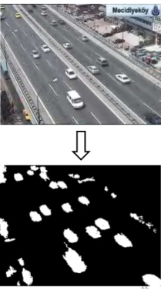
Background Subtraction
Process of automatically separating out foreground objects from background
Applications:
Traffic monitoring
Real-time motion gesture recognition
Video surveillance – Monitor behavior or activities for the purpose of managing, directing, or protecting people

Slide 5
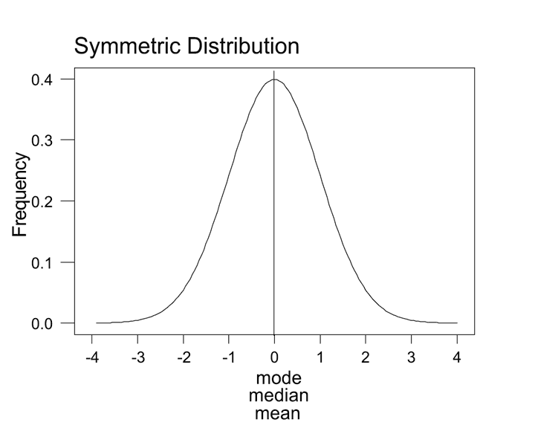
Gaussian
Background subtraction uses gaussian properties
If the frequency distribution of a data set forms a bell-shaped curve then the data is Gaussian.

Slide 6
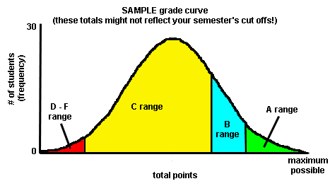
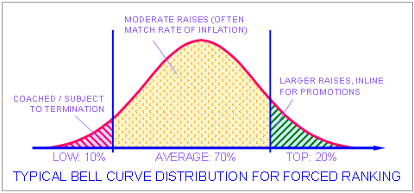
Gaussian Examples
Grades of students in a class was gaussian
Salary appraisals of employees is gaussian

Slide 7
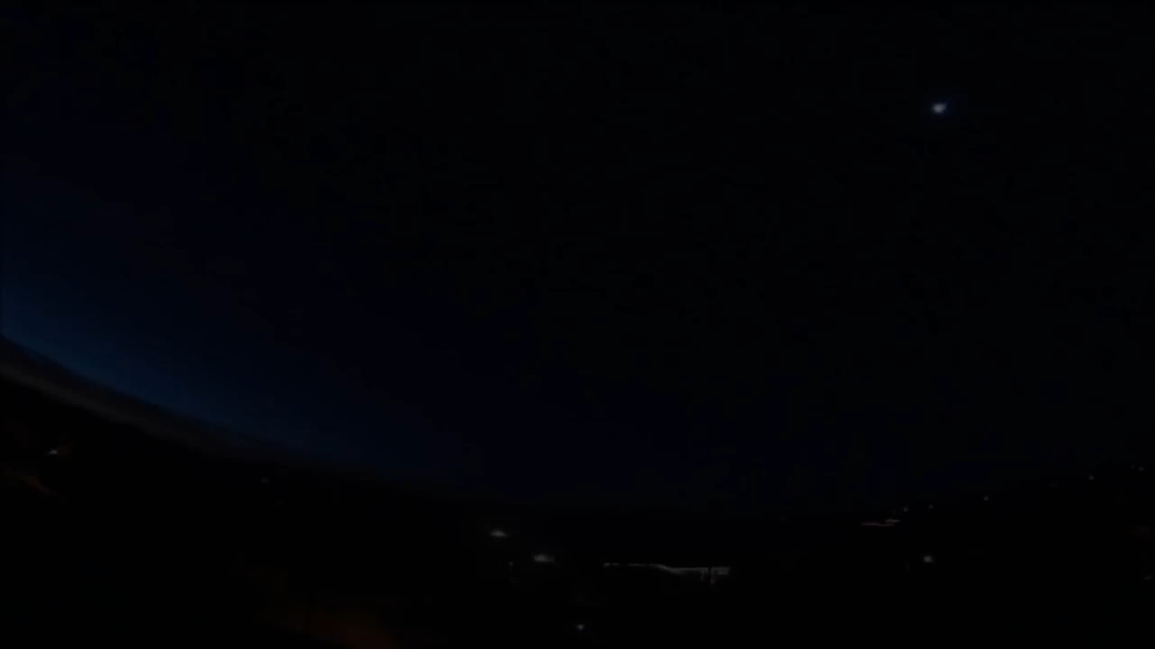
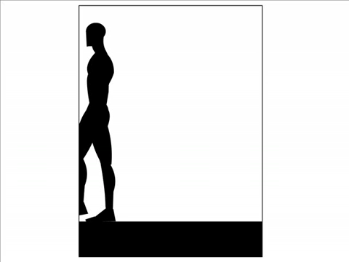
Mixture of Gaussian
Black
White
Black
White
Notes:
1) Picel is for representstion
2) Show that this is video

Slide 8
Stauffer Grimson Algorithm
Algorithm to subtract background / foreground from video
Assumptions
The background of the input video is quite constant throughout except for minor movements like movement of leaves of a tree
Most parts of the video are background and very small parts of the video are foreground
There are no abrupt changes in foreground

Slide 9
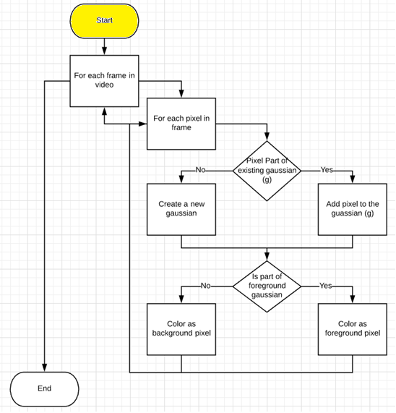
Stauffer Grimson Algorithm

Slide 10
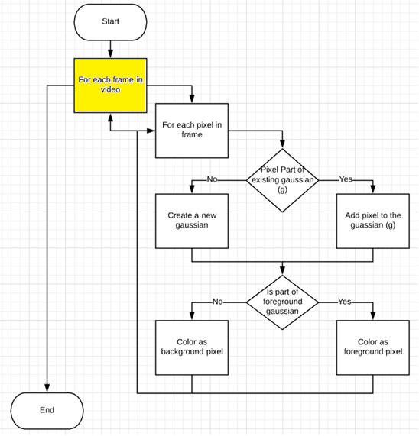

Stauffer Grimson Algorithm

Slide 11
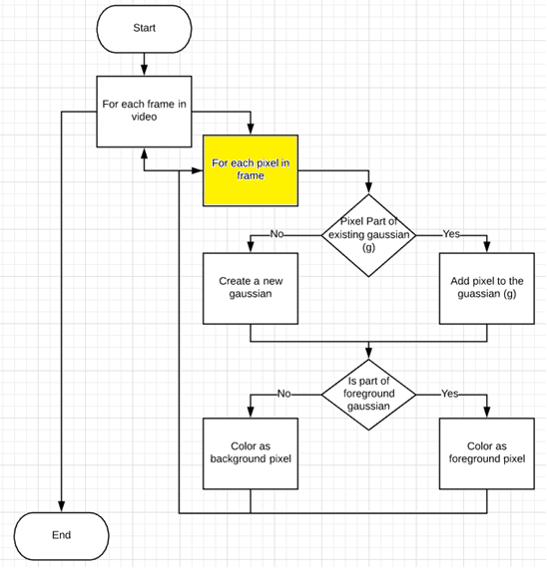
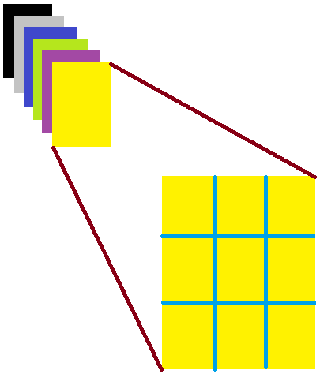
Stauffer Grimson Algorithm

Slide 12
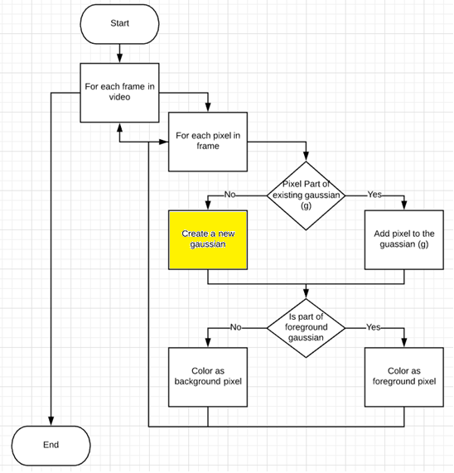
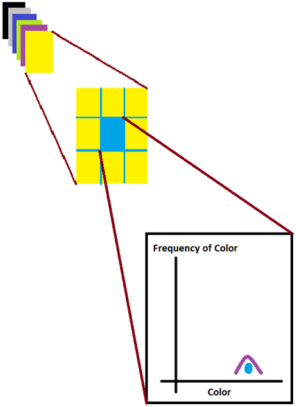
Stauffer Grimson Algorithm
1st Frame
5th Pixel
µ | Pixel Color
σ | Some fixed value e.g. 20
# | 1
Notes:
For undersyadning purpose I have drawn a graph here and in future slides. However he algorithm stores only 3 values per gaussian, mean, standard deviation and number of pixel colors
Draw table with 3 parameters

Slide 13
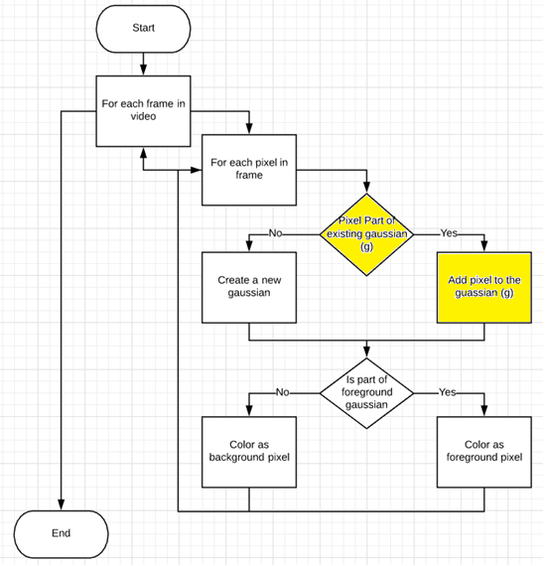
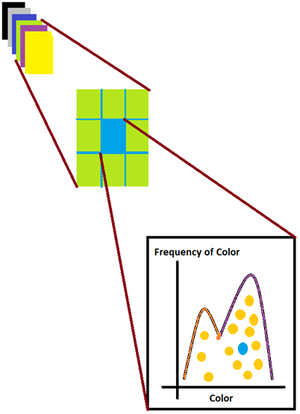
Stauffer Grimson Algorithm
15th Frame
5th Pixel
µ | 100
σ | 35
# | 5
µ | 198
σ | 25
# | 9
Notes:
U might be wondering how I got to know that these are 2 gaussians
-2 sigma to +2 sigma pixel part

Slide 14
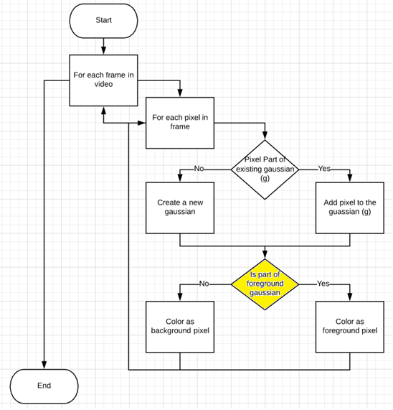
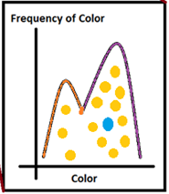
Stauffer Grimson Algorithm
Assumption – Most of the video is background, say 90% is background
We start with the highest frequency gaussian
We keep adding the frequency of other gaussians in sorted order till we reach 90%
All these selected gaussians form the background
Notes:
Assume – background gaussian will remain max no of time wirh max pixels

Slide 15
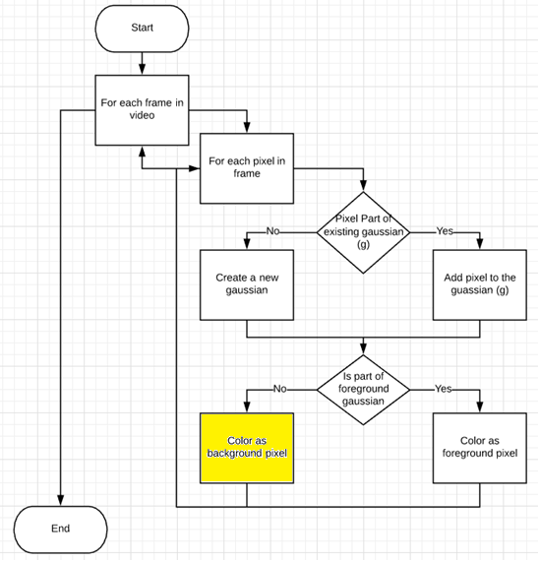
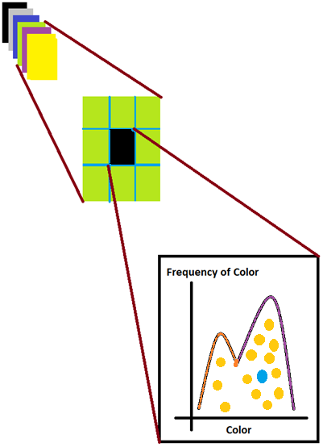
Stauffer Grimson Algorithm
15th Frame
5th Pixel
Pixel marked as background
µ | 100
σ | 35
# | 5
µ | 200
σ | 30
# | 10

Slide 16
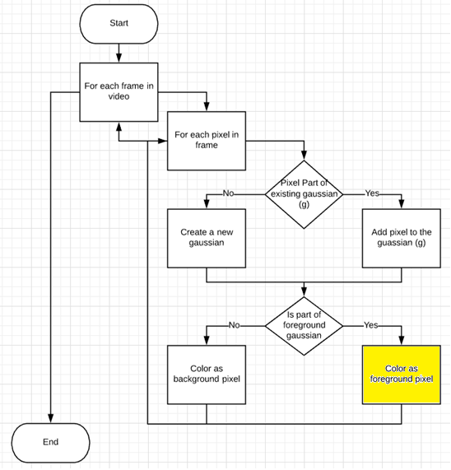
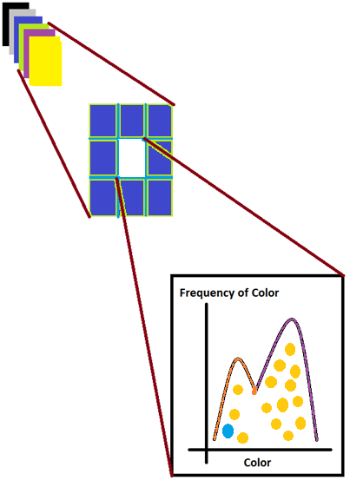
Stauffer Grimson Algorithm
16th Frame
5th Pixel
Pixel marked as foreground
µ | 97
σ | 38
# | 6
µ | 200
σ | 30
# | 10

Slide 17
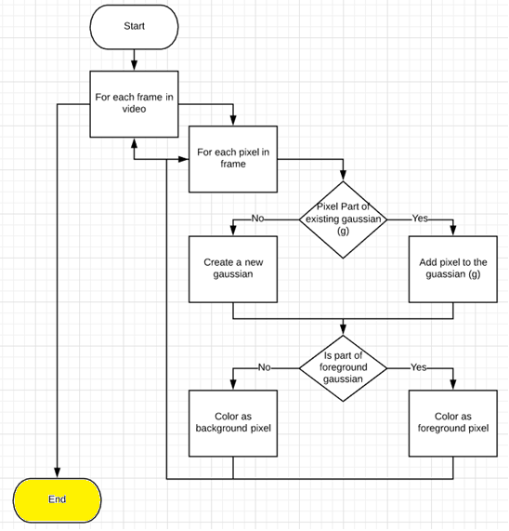
Stauffer Grimson Algorithm
If there are 40,000 pixels in a frame then, at any point in time, there will be 40,000 mixtures of gaussians.
1 mixture of gaussians per pixel

Slide 18
How Machine Learning is used in Algorithm
What is the dictionary meaning of “learning”
Learning is the acquisition of knowledge or skills through study, experience, or being taught.
In this algorithm we teach the machine
how to construct gaussians (calculate mean and variance) with each new pixel
how to distinguish the gaussian as foreground or background

Slide 19
Demo

Slide 20
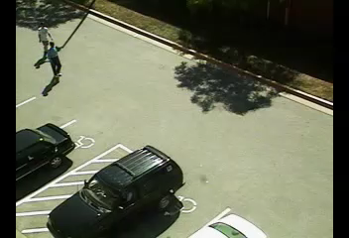


Slide 21
Application of ML in EDA
Finding behavioral model of user circuit using Machine Learning
Compare user circuit with pre-existing circuits in database
The behavior of the matched circuit can be used as is for the user circuit
This can reduce computation time of finding behavior of user circuit
Paper - https://www.alexandria.ucsb.edu/lib/ark:/48907/f3f18wwm

Slide 23
Advantages over Frame Subtraction Algorithm
Frame Subtraction Algorithm
Another type of background subtraction algorithm
Subtract 2 frames. Background will be left out. Foreground will remain
Advantage of Stauffer Grimson
Leaves movement of a tree should be a background. But Frame subtraction algorithm will consider that as foreground

Slide 24
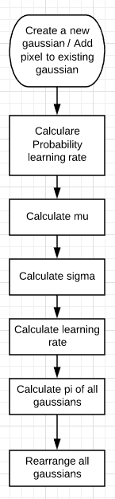
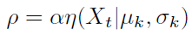
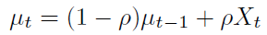
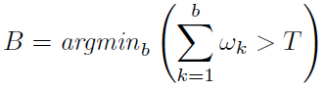
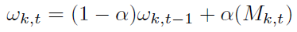
Stauffer Grimson Algorithm
a = 1 / totalEleInMixtureOfGuassians
wk,t / sigma

Slide 25
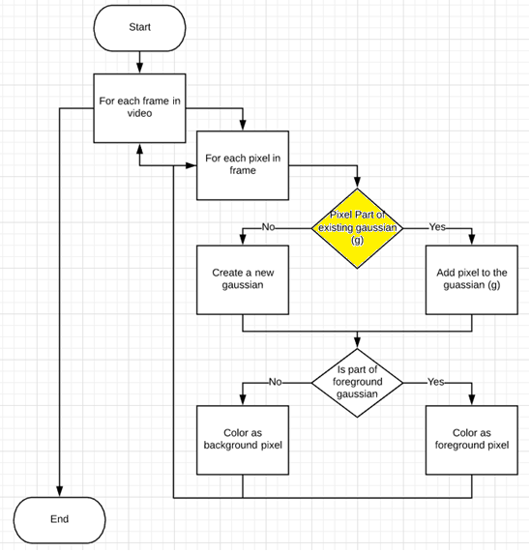
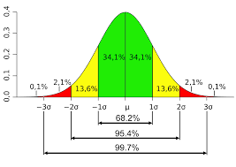
Stauffer Grimson Algorithm
µ - Mean
σ – Standard Deviation

Slide 26
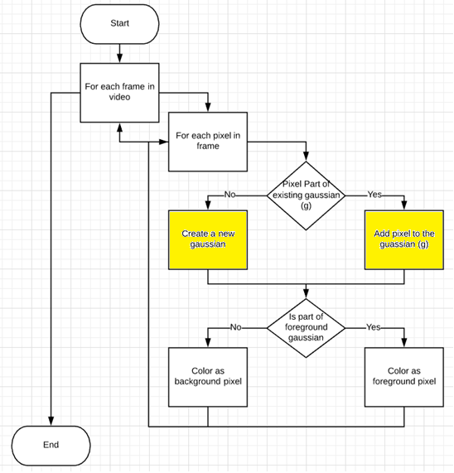
Stauffer Grimson Algorithm
What is the probability of the pixel that it will be a part of the gaussian
Mean of the gaussian
Standard deviation of the gaussian
Fraction of new information to be considered for recalculating the gaussian parameters
Contribution of a gaussian in the mixture of gaussians
Arrange gaussians in decreasing order of number of pixels in the gaussian

